Slide 1
NEURAL DUST
Somya Ranjan kabi
Regd. No. – 2201229187
7th Semester, SEC - C
Under the guidance of
Prof. Anita Mohanty
Department of Computer Science and Engineering
DRIEMS UNIVERSITY, Tangi, Cuttack

Slide 2

Outline
Introduction
History
Components
Work Flow
Application
Challenges
Future Scopes
Conclusion
References

Slide 3
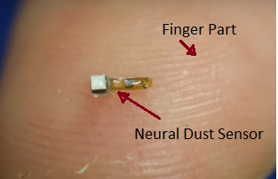
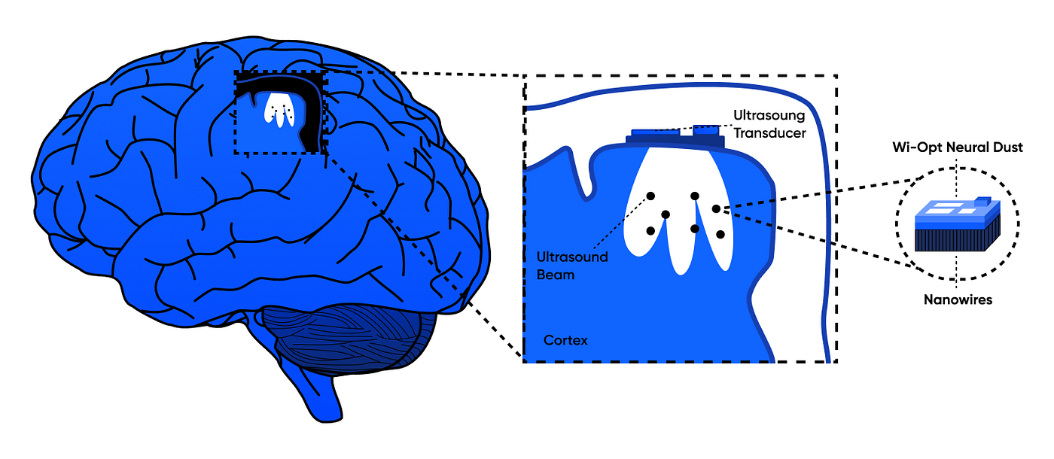
Introduction
Neural Dust:
Imagine a world where devices monitor organs or control prosthetics without wires or invasive surgeries. This isn't science fiction; it's the promise of Neural Dust.
These groundbreaking systems represent a paradigm shift in medical technology, bridging the gap between human biology and advanced electronics

Slide 4
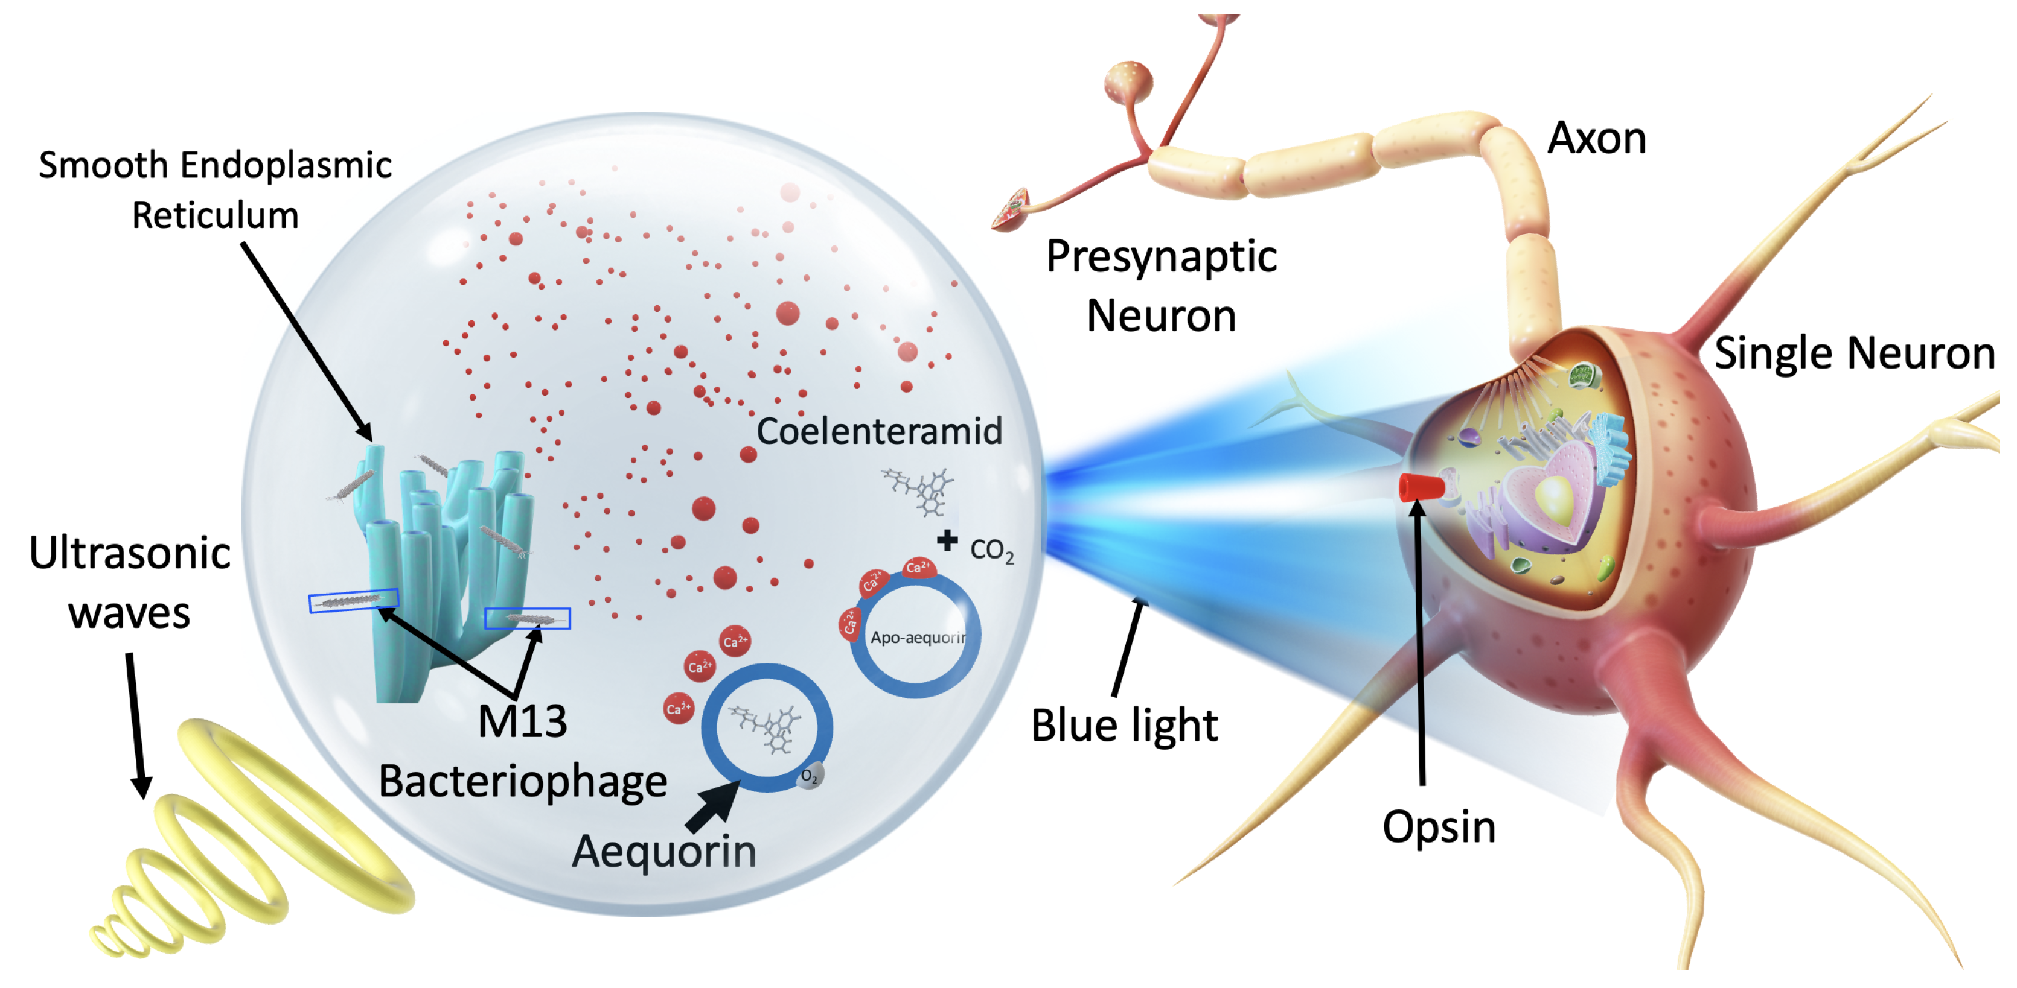
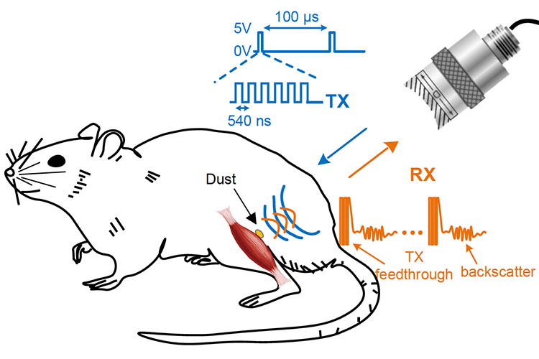
History
2013
2016 onward
1
4
Concept introduced by a research team at University of California, Berkeley led by Michel Maharbiz and José Carmena.
Goal: Replace bulky wired implants with tiny wireless sensors.
Early experiments: Animal trials to monitor nerve signals.
Miniaturization improved; tested for brain and muscle signal monitoring.
Present – Research expanding into prosthetics, electroceuticals, and brain-computer interfaces.

Slide 5
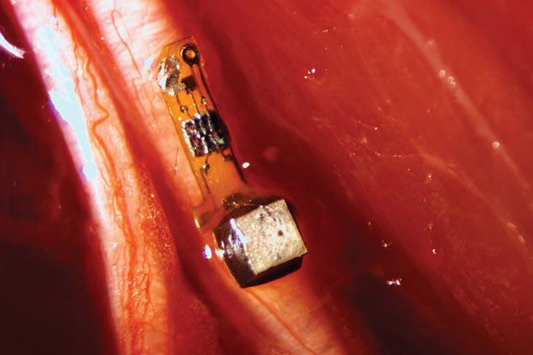
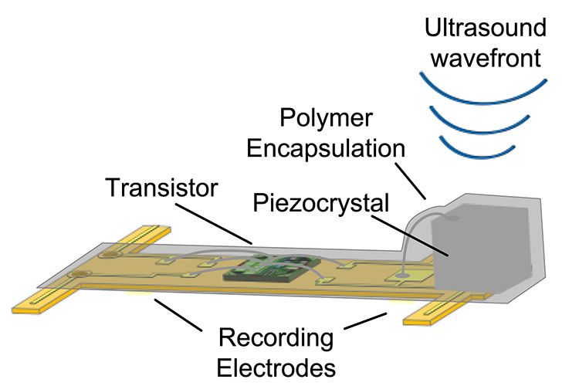
Components

Slide 6
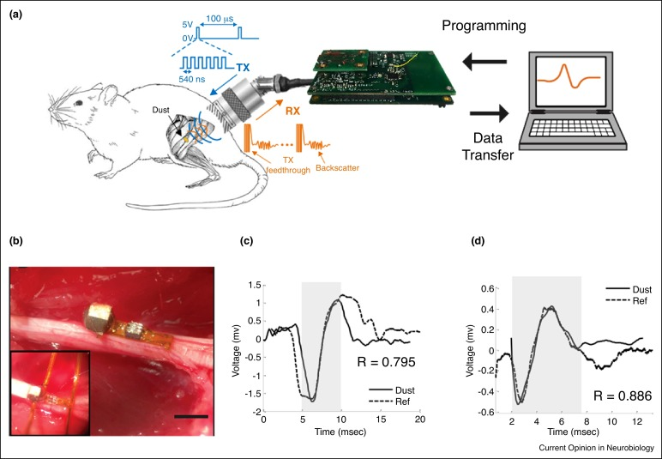
Work Flow

Slide 7
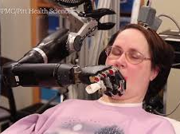
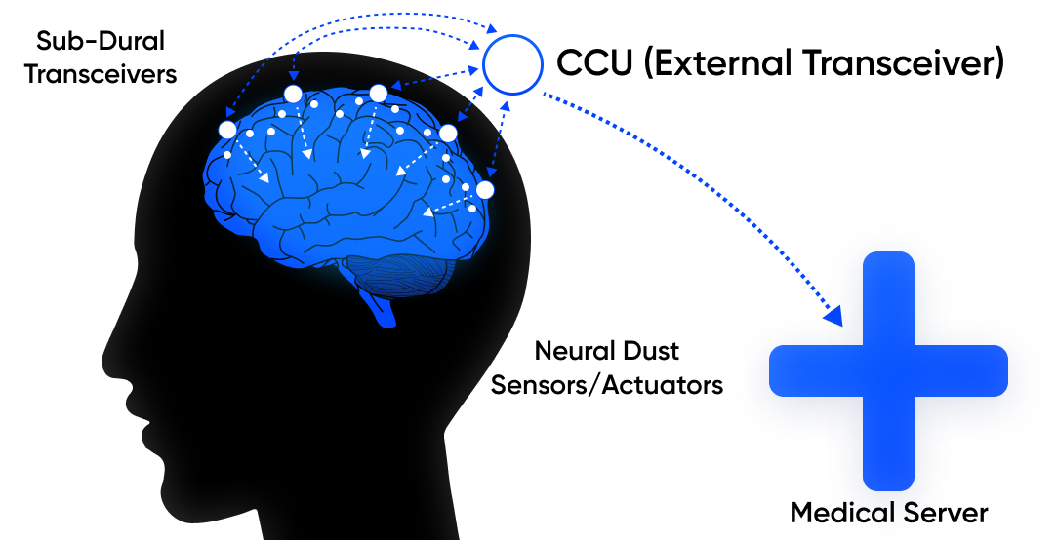
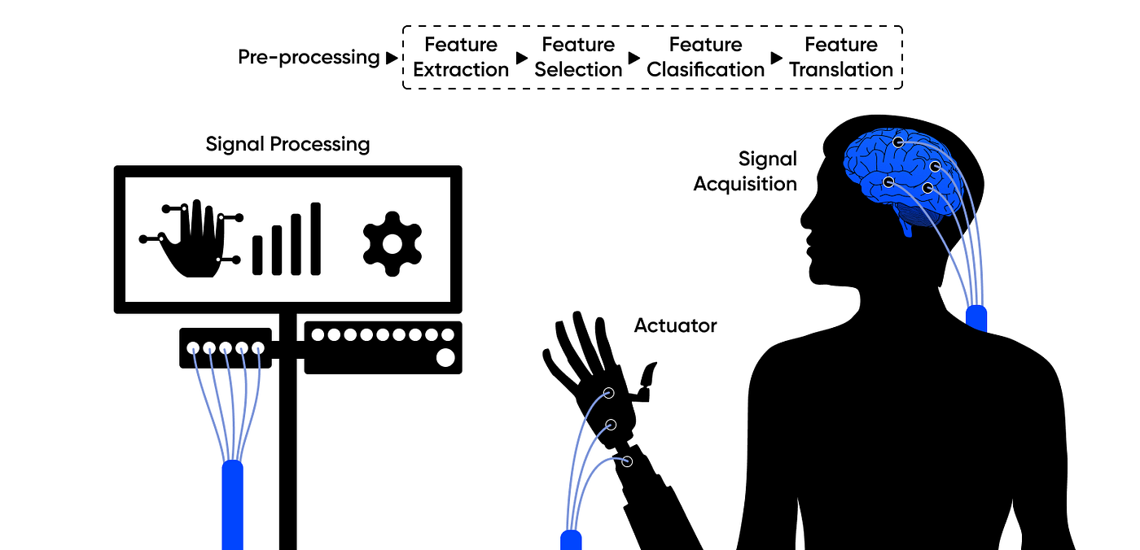
Application
Health Monitoring:
Continuous tracking of vital signs like blood pressure, glucose levels, and heart activity without the need for bulky wearable devices.
Brain-Machine Interfaces:
Directly connect the brain to computers or prosthetic limbs for control through neural signals.
Paralysis Rehabilitation:
Help paraplegic patients control external devices or robotic limbs using thought signals.

Slide 8
Challenges
1
2
Technical Challenges
Miniaturization Limitations
Data Transmission Reliability
Power Supply
Regulatory and Cost Barriers
Approval Delays
Affordability
3
4
Biological & Medical Risks
Tissue Damage
Immune System Reaction
Ultrasound Safety Concerns
Ethical and Privacy Concerns
Data Security
Human Augmentation Debate
Consent & Control

Slide 9
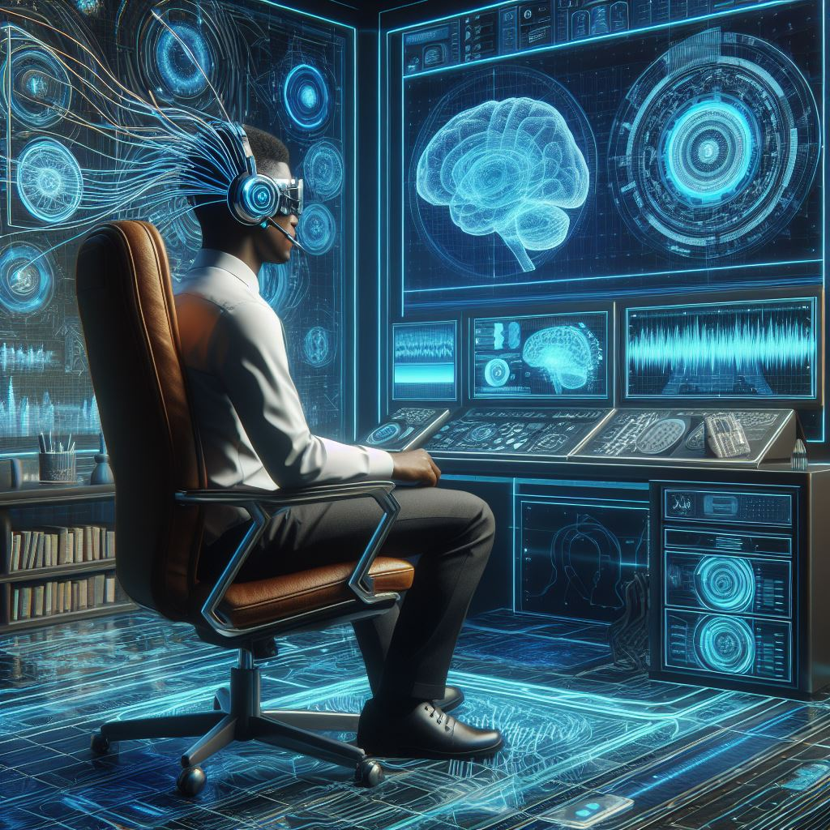
Future Scopes
1
Fully Wireless Body-Wide Monitoring
Neural dust could enable a complete, networked system of tiny sensors spread throughout the body, continuously monitoring brain activity, organ health, and metabolism without invasive wires.
2
Advanced Brain-Machine Interfaces
Future versions may allow seamless control of prosthetic limbs, computers, or even vehicles directly through thought, with higher precision and lower power consumption than current BCI devices.
3
Next-Generation Medical Diagnostics
5
Doctors could detect diseases like cancer, epilepsy, or heart problems at a very early stage by monitoring real-time cellular and neural activity.

Slide 10
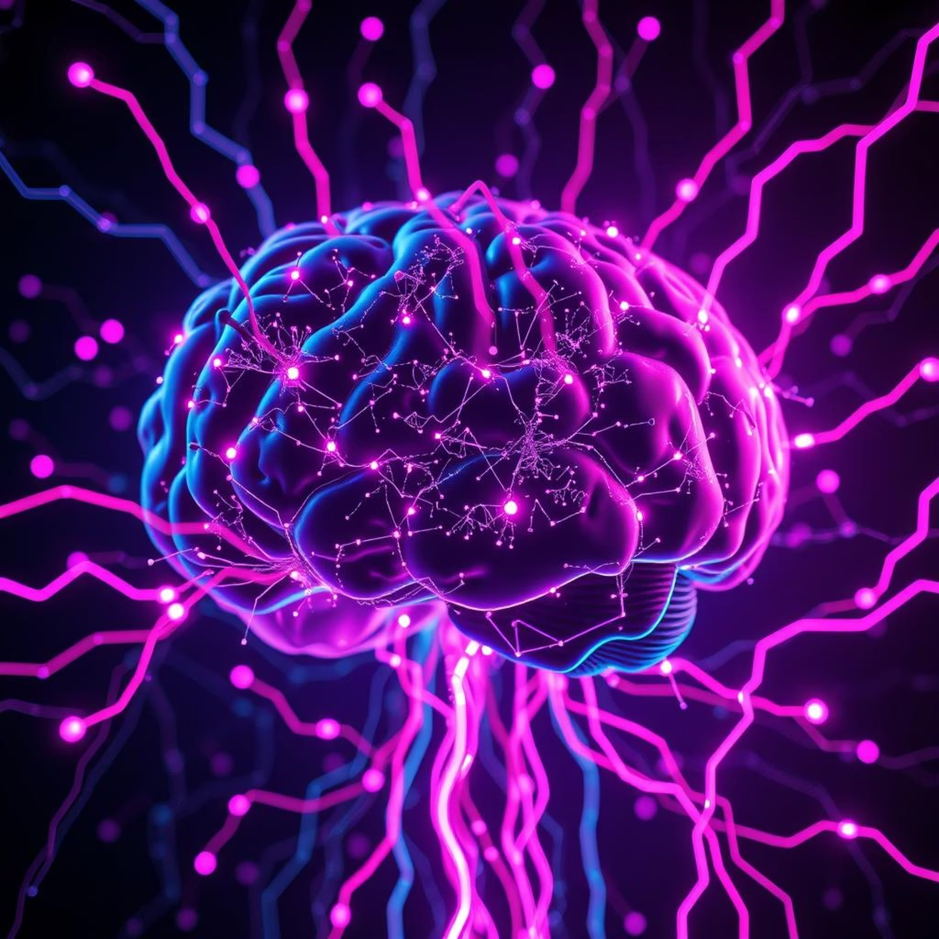
Conclusion
Neural Dust
(Future of Bio-Integrated Wireless Systems)
Neural dust is a promising leap toward wireless, minimally invasive body–machine communication. Using ultrasound for power and data transfer, it offers vast potential in health monitoring, brain–machine interfaces, and medical treatments. Though challenges like safety, durability, and ethics remain, continued research could make it a key technology in the future of healthcare and human enhancement.

Slide 11
References
Research Papers & Articles:
https://www.universityofcalifornia.edu/news/neural-dust-could-treat-body-inside
https://www.mdpi.com/2673-3951/6/1/8
https://www.sciencedirect.com/science/article/pii/S2667325824001559
https://www.medicaldesignandoutsourcing.com/sprinkling-of-neural-dust-opens-door-to-electroceuticals
Book&Guidelines
Brain–Computer Interfaces: Principles and Practice
Neuroengineering (by Bin He, ed.)
Bioelectrical Interfaces (various authors in IEEE series)

Slide 12

Any Queries…?

Slide 13
Thank You

